Slide 1
Lec 11: Properties of LTI System + Differential and difference equations
Dr. Arsla Khan

Slide 2
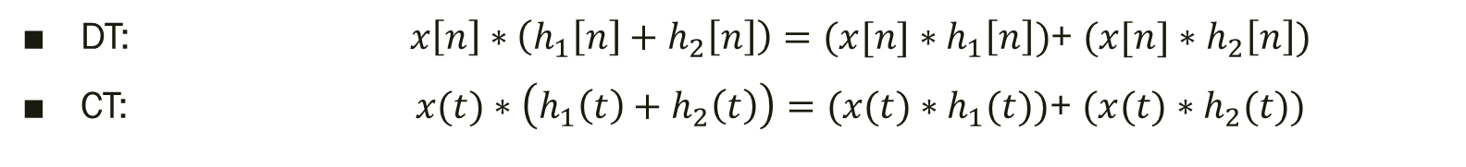

1. The Commutative Property
DT: $x\left[n\right]∗h\left[n\right]=h\left[n\right]∗x\left[n\right]$
CT: $x(t)∗h(t)=h(t)∗x(t)$
2. The Distributive Property
DT: $x\left[n\right]∗\left(h_{1}\left[n\right]+h_{2}\left[n\right]\right)=(x[n]∗h_{1}\left[n\right])$+ $(x[n]∗h_{2}\left[n\right])$
CT:$x(t)∗\left(h_{1}\left(t\right)+h_{2}\left(t\right)\right)=(x(t)∗h_{1}(t))$+ $(x(t)∗h_{2}(t))$

Slide 3
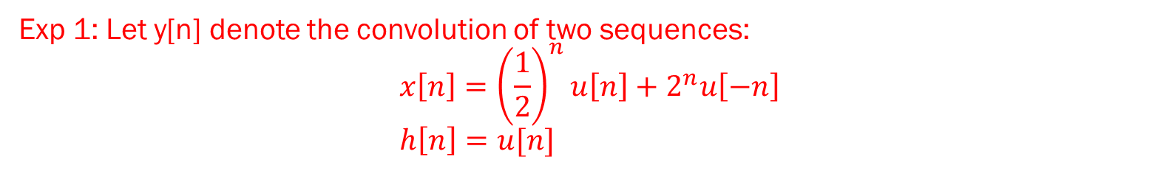
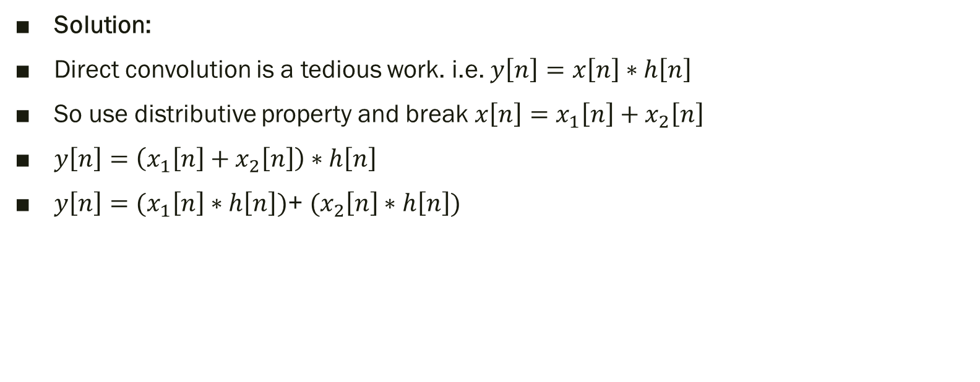
Exp 1: Let y[n] denote the convolution of two sequences: $$x\left[n\right]={\left(\frac{1}{2}\right)}^{n}u\left[n\right]+2^{n}u\left[−n\right] \\ h\left[n\right]=u[n]$$
Solution:
Direct convolution is a tedious work. i.e. $y\left[n\right]=x\left[n\right]∗h\left[n\right]$
So use distributive property and break $x\left[n\right]=x_{1}\left[n\right]+x_{2}\left[n\right]$
$y\left[n\right]=\left(x_{1}\left[n\right]+x_{2}\left[n\right]\right)∗h\left[n\right]$
$y\left[n\right]=(x_{1}\left[n\right]∗h\left[n\right])\text{+ }(x_{2}\left[n\right]∗h\left[n\right])$

Slide 4

3. The Associative Property
DT: $x\left[n\right]∗{(h}_{1}\left[n\right]∗h_{2}\left[n\right])=(x\left[n\right]∗h_{1}\left[n\right])∗h_{2}\left[n\right]$
CT: $x(t)∗{(h}_{1}(t)∗h_{2}(t))=(x(t)∗h_{1}(t))∗h_{2}(t)$

Slide 5
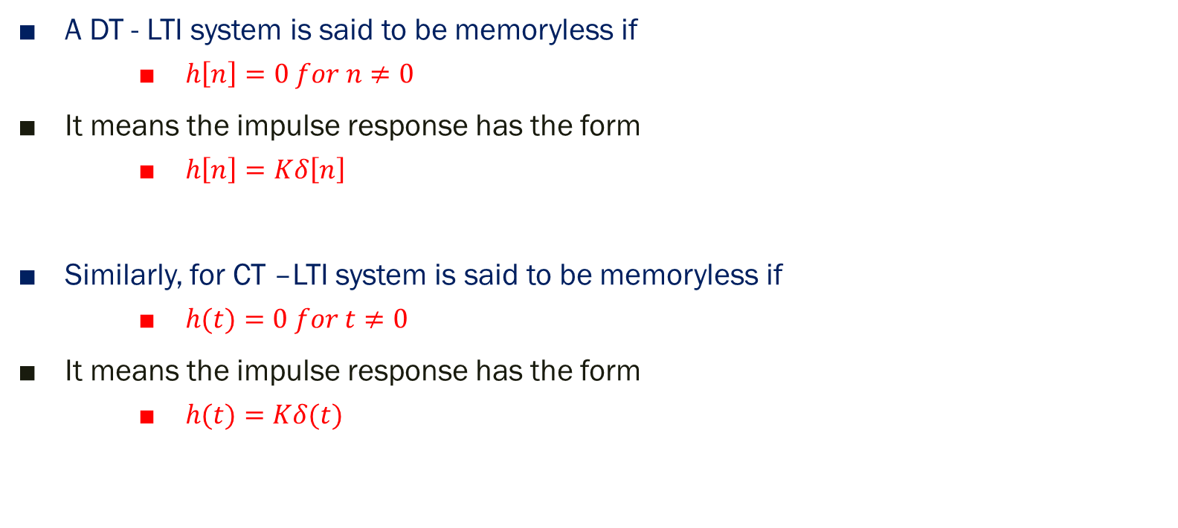
4. LTI system with and without memory
K
A DT - LTI system is said to be memoryless if
$h\left[n\right]=0 for n≠0$
It means the impulse response has the form
$h\left[n\right]=Kδ\left[n\right]$
Similarly, for CT –LTI system is said to be memoryless if
$h(t)=0 for t≠0$
It means the impulse response has the form
$h(t)=Kδ(t)$

Slide 6

Exp 2: (a) $h\left(t\right)=5δ\left(t−2\right)$ (b) $y\left(t\right)=3x\left(t+2\right)$ (c) $h\left[n\right]=6δ[n]$
(a) $h\left(t\right)=5δ\left(t−2\right)$
Condition is $h(t)=0 for t≠0$
Condition is not satisfied so dynamic system
(b) $y\left(t\right)=3x(t+2)$
Replace $y\left(t\right)=h(t)$ and $x\left(t\right)=δ\left(t\right)$
$h\left(t\right)=3δ(t+2)$
Condition is not satisfied so dynamic system
(c) $h\left[n\right]=6δ\left[n\right]$
Condition is satisfied so static system

Slide 7

5. Causality for LTI system
A DT - LTI system is causal only and only if
$h\left[n\right]=0 for n<0$
Similarly, CT – LTI system is causal only and only if
$h\left(t\right)=0 for t<0$

Slide 8
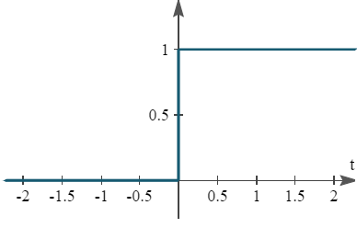

Exp 3: (a) $h\left(t\right)=u(t)$ (b) $y\left(t\right)=3x\left(t+2\right)$ (c) $h\left[n\right]=6δ[n]$
(a) $h\left(t\right)=u(t)$
$h\left(t\right)=0 for t<0$ so causal system
(b) $y\left(t\right)=3x(t+2)$
Replace $y\left(t\right)=h(t)$ and $x\left(t\right)=δ\left(t\right)$
$h\left(t\right)=3δ(t+2)$
Non-Causal
(c) $h\left[n\right]=6δ\left[n\right]$
Causal

Slide 9

6. Stability of LTI system
A DT - LTI system is stable only and only if
$\sum_{k=−∞}^{∞}{\left|h[k]\right|<∞}$
Similarly, CT – LTI system is stable only and only if
$\int_{−∞}^{∞}{\left|h(t)\right|dt} <∞$

Slide 10
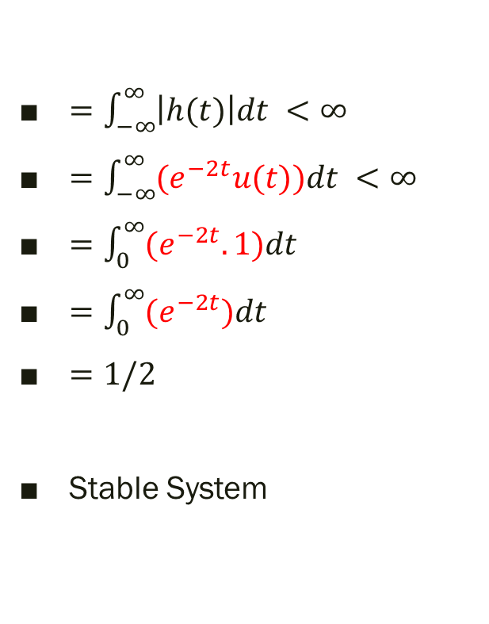

Exp 4: (a) $h\left(t\right)=e^{−2t}u\left(t\right) \text{(}\text{b}\text{) }h\left(t\right)=u\left(t\right)−u(t−2)$
$=\int_{−∞}^{∞}{\left|h(t)\right|dt} <∞$
$=\int_{−∞}^{∞}{{(e}^{−2t}u(t))dt} <∞$
$=\int_{0}^{∞}{{(e}^{−2t}.1)dt}$
$=\int_{0}^{∞}{{(e}^{−2t})dt}$
$=1/2$
Stable System
$=\int_{−∞}^{∞}{\left|h(t)\right|dt} <∞$
$=\int_{0}^{2}{1.dt}$
$=$ ${t|}_{0}^{2}$
$=2$
Stable System

Slide 11
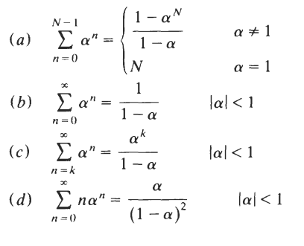

Slide 12

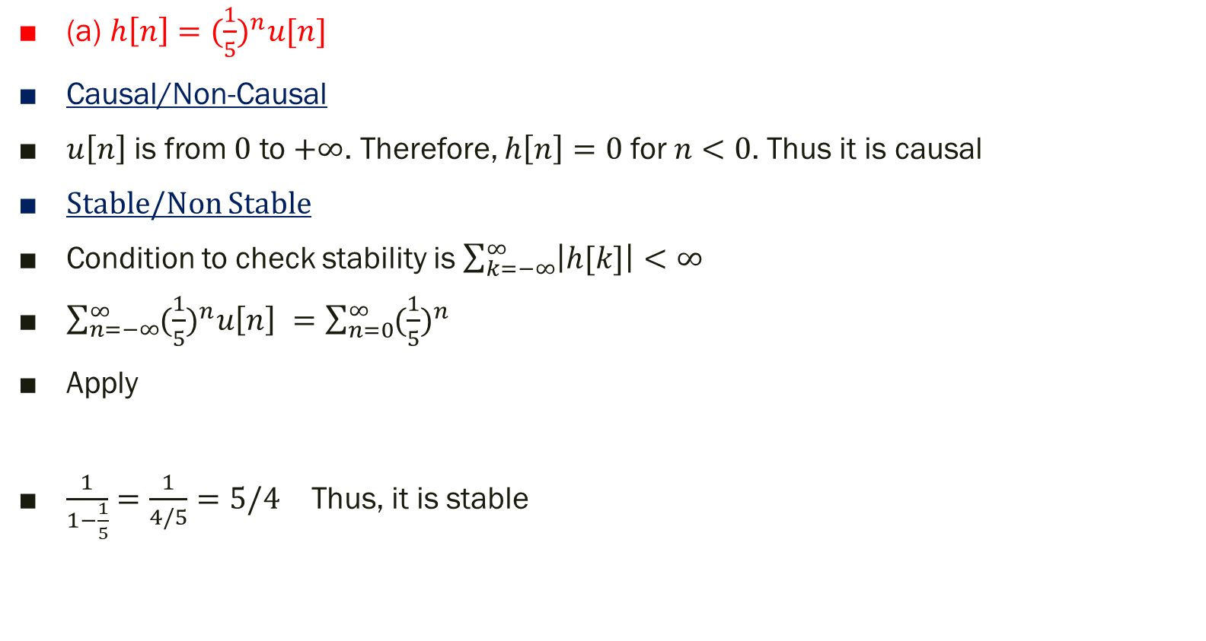
Check whether the systems are causal and stable or not?
(a) $h\left[n\right]={(\frac{1}{5})}^{n}u[n]$
Causal/Non-Causal
$u\left[n\right]$ is from $0$ to $+∞$. Therefore, $h\left[n\right]=0$ for $n<0$. Thus it is causal
Stable/Non Stable
Condition to check stability is $\sum_{k=−∞}^{∞}{\left|h[k]\right|<∞}$
$\sum_{n=−∞}^{∞}{{(\frac{1}{5})}^{n}u\left[n\right] }=\sum_{n=0}^{∞}{{(\frac{1}{5})}^{n}}$
Apply
$\frac{1}{1−\frac{1}{5}}=\frac{1}{4/5}=5/4$ Thus, it is stable

Slide 13
Causal LTI System described by Differential and Difference Equations
Differential Equation → CT systems
Difference Equation → DT systems
Causal LTI systems follows
Linearity
Time Invariance
Causality

Slide 14
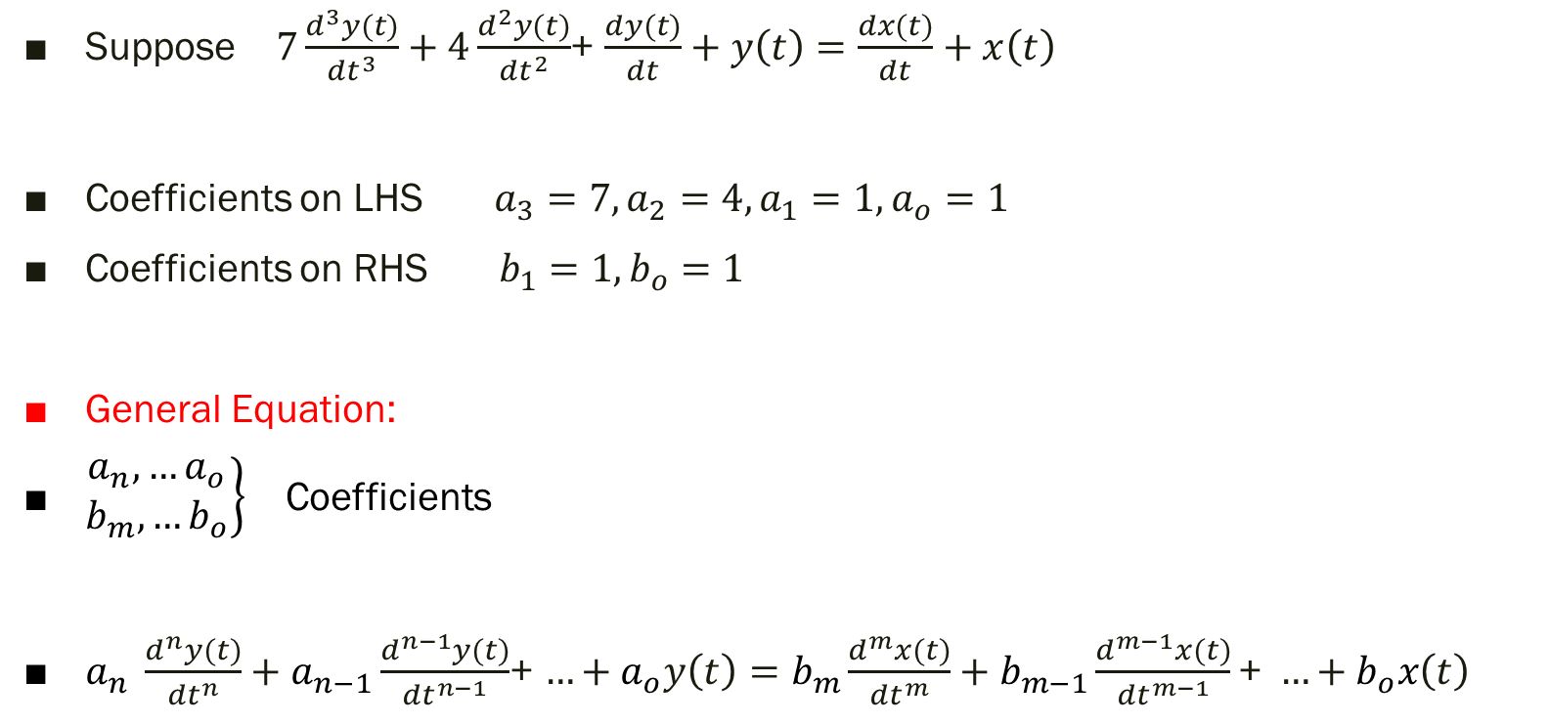
1. Standard Differential equation for Causal LTI Systems
Suppose $7\frac{d^{3}y(t)}{{dt}^{3}}+4\frac{d^{2}y(t)}{{dt}^{2}}$+ $\frac{dy(t)}{dt}+y\left(t\right)=\frac{dx(t)}{dt}+x\left(t\right)$
Coefficients on LHS $a_{3}=7, a_{2}=4, a_{1}=1, a_{o}=1$
Coefficients on RHS $b_{1}=1, b_{o}=1$
General Equation:
$\left.\begin{matrix}a_{n},…a_{o} \\ b_{m},…b_{o}\end{matrix}\right\}$ Coefficients
$a_{n} \frac{d^{n}y(t)}{{dt}^{n}}+a_{n−1}\frac{d^{n−1}y(t)}{{dt}^{n−1}}$+ $…+a_{o}y\left(t\right)=b_{m}\frac{d^{m}x(t)}{{dt}^{m}}+b_{m−1}\frac{d^{m−1}x(t)}{{dt}^{m−1}}\text{+ }…+b_{o}x\left(t\right)$

Slide 15
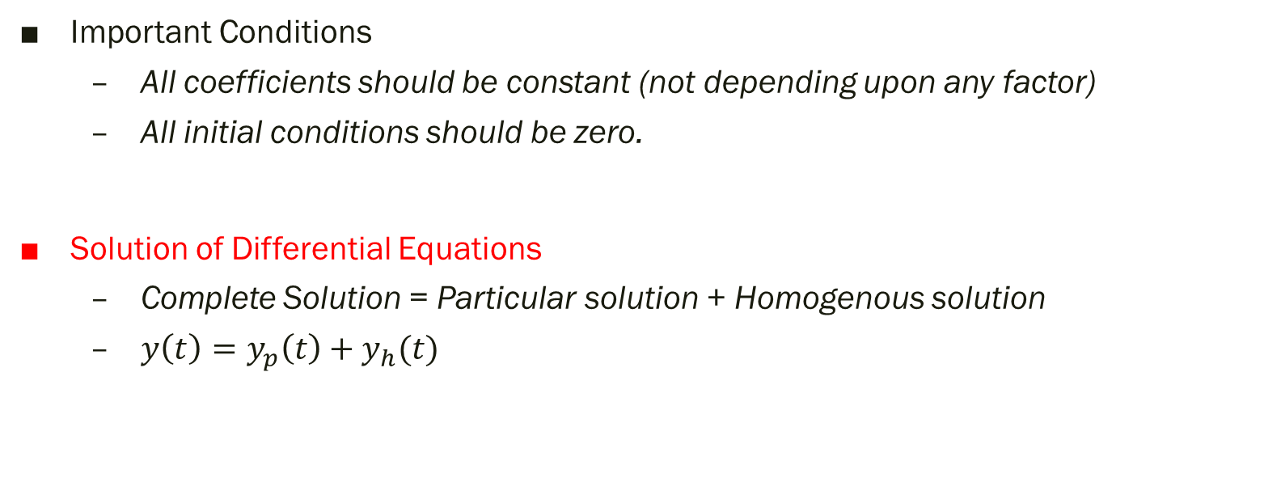
Important Conditions
All coefficients should be constant (not depending upon any factor)
All initial conditions should be zero.
Solution of Differential Equations
Complete Solution = Particular solution + Homogenous solution
$y\left(t\right)=y_{p}\left(t\right)+y_{h}(t)$

Slide 16
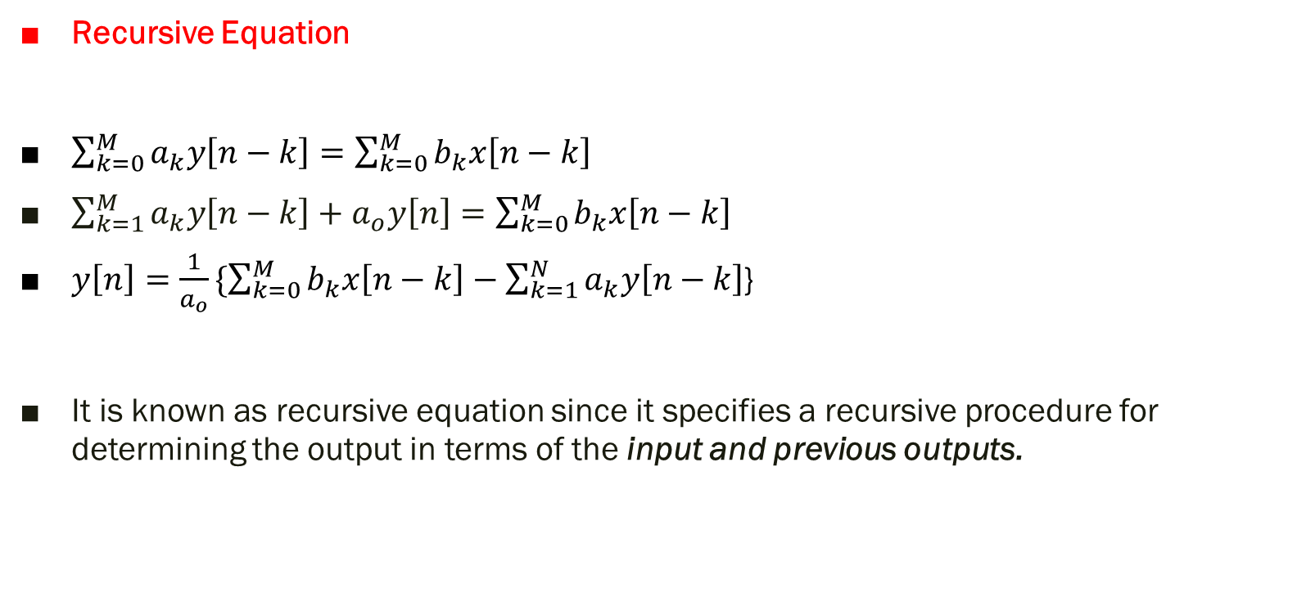
2. Standard Difference equation for Causal LTI Systems
Recursive Equation
$\sum_{k=0}^{M}{a_{k}y\left[n−k\right]=\sum_{k=0}^{M}{b_{k}x\left[n−k\right]}}$
$\sum_{k=1}^{M}{a_{k}y\left[n−k\right]+a_{o}y\left[n\right]=\sum_{k=0}^{M}{b_{k}x\left[n−k\right]}}$
$y\left[n\right]=\frac{1}{a_{o}}\{\sum_{k=0}^{M}{b_{k}x\left[n−k\right]}−\sum_{k=1}^{N}{a_{k}y\left[n−k\right]}$}
It is known as recursive equation since it specifies a recursive procedure for determining the output in terms of the input and previous outputs.

Slide 17

Non- recursive Equation
$y\left[n\right]=\frac{1}{a_{o}}\sum_{k=0}^{M}{b_{k}x\left[n−k\right]}$
It is known as non-recursive equation since previous output values are not required to compute the present output.

Slide 18
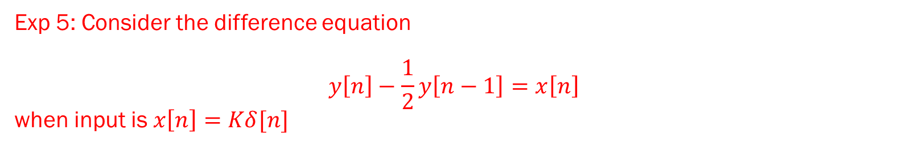
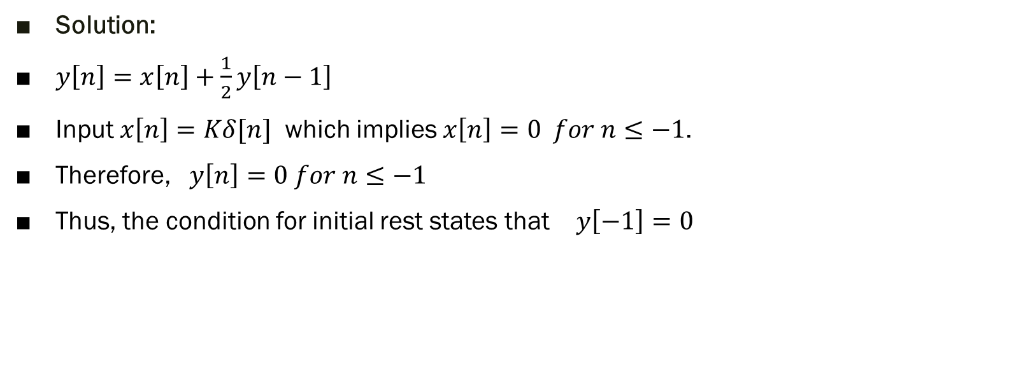
Exp 5: Consider the difference equation
$$y\left[n\right]−\frac{1}{2}y\left[n−1\right]=x\left[n\right]$$
when input is $x\left[n\right]=Kδ[n]$
Solution:
$y\left[n\right]=x\left[n\right]+\frac{1}{2}y\left[n−1\right]$
Input $x\left[n\right]=Kδ[n]$ which implies $x\left[n\right]=0 for n≤−1$.
Therefore, $y\left[n\right]=0 for n≤−1$
Thus, the condition for initial rest states that $y\left[−1\right]=0$

Slide 19


First sample of $x\left[n\right]$ is at $n=0$ so the starting point of recursion is $n=0$
For $n=0$
$y\left[0\right]=x\left[0\right]+\frac{1}{2}y\left[−1\right]$
$y\left[0\right]=K+0$
$y\left[0\right]=K$
For $n=1$
$y\left[1\right]=x\left[1\right]+\frac{1}{2}y\left[0\right]$
$y\left[1\right]=0+\frac{1}{2}K$
$y\left[1\right]=\frac{1}{2}K$
For $n=2$
$y\left[2\right]=x\left[2\right]+\frac{1}{2}y\left[1\right]$
$y\left[2\right]=0+{(\frac{1}{2})}^{2}K$
$y\left[2\right]={(\frac{1}{2})}^{2}K$
……
For $n=n$
$y\left[n\right]=x\left[n\right]+\frac{1}{2}y\left[n−1\right]$
$y\left[n\right]={(\frac{1}{2})}^{n}K$

Slide 20
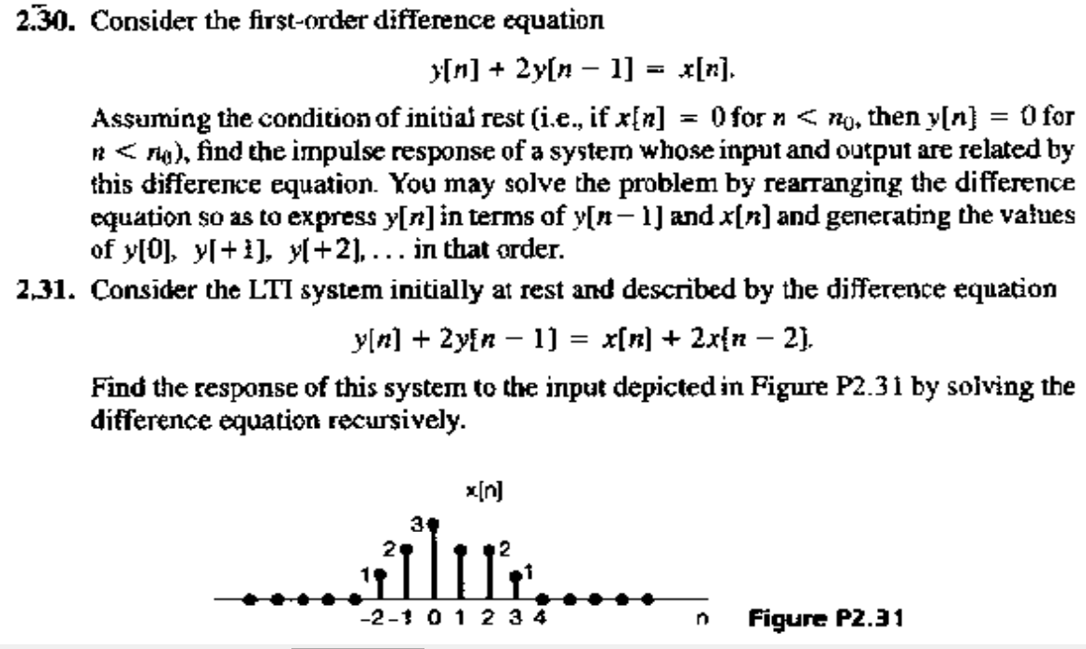
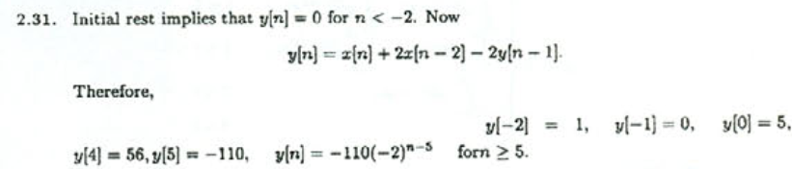
Exp 6:
Solution:

Slide 21

$y\left[n\right]=x\left[n\right]+2x\left[n−2\right]−2y\left[n−1\right]$
For $n=−2$
$y\left[−2\right]=x\left[−2\right]+2x\left[−4\right]−2y\left[−3\right]$
$y\left[−2\right]=1+2\left(0\right)−2(0)$
$y\left[−2\right]=$1
For $n=−1$
$y\left[−1\right]=x\left[−1\right]+2x\left[−3\right]−2y\left[−2\right]$
$y\left[−1\right]=2+2\left(0\right)−2(1)$
$y\left[−1\right]=0$
For $n=0$
$y\left[0\right]=x\left[0\right]+2x\left[−2\right]−2y\left[−1\right]$
$y\left[0\right]=3+2\left(1\right)−2(0)$
$y\left[0\right]=5$

Slide 22
PP.

Slide 23
Thank You !!!

